Slide 1
Decisions Making

Slide 2
The if Statement
Allows statements to be conditionally executed or skipped over
Models the way we mentally evaluate situations:
  "If it is raining, take an umbrella."
  "If it is cold outside, wear a coat."

Slide 3
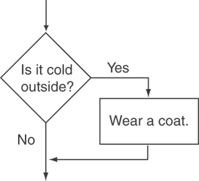
Flowchart for Evaluating a Decision

Slide 4
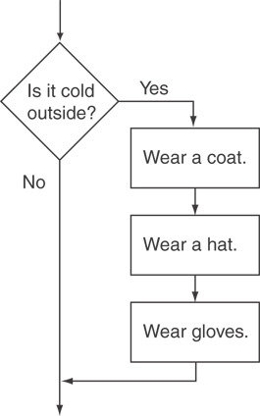
Another Flowchart

Slide 5
The if Statement
  if (expression)
  statement;
The expression must evaluate to true or false.
The “statement” can be a group of statements in braces:
If (expression)
{
Statement 1;
Statement 2;
}

Slide 6
Notes on if
Do not place ; after (expression)
Place statement; on a separate line after (expression):
  if (score > 90)
  grade = 'A';
Be careful testing floats and doubles for equality
0 is false; any other value is true

Slide 7
The if/else statement
Provides two possible paths of execution
Performs one statement or block if the expression is true, otherwise performs another statement or block.

Slide 8
The if/else statement
General Format:
  if (expression)
  statement1; // or block
  else
  statement2; // or block

Slide 9
The if/else statement
To evaluate:
  if (expression)
  statement1;
  else
  statement2;
If the expression is true, then statement1 is executed and statement2 is skipped.
If the expression is false, then statement1 is skipped and statement2 is executed.

Slide 10
If-else example
int x = 3;
if (x % 2==0)
  cout << “Number is odd”;
  else
  cout << “Number is even”;

Slide 11
Nested if Statements
An if statement that is nested inside another if statement
Nested if statements can be used to test more than one condition

Slide 12
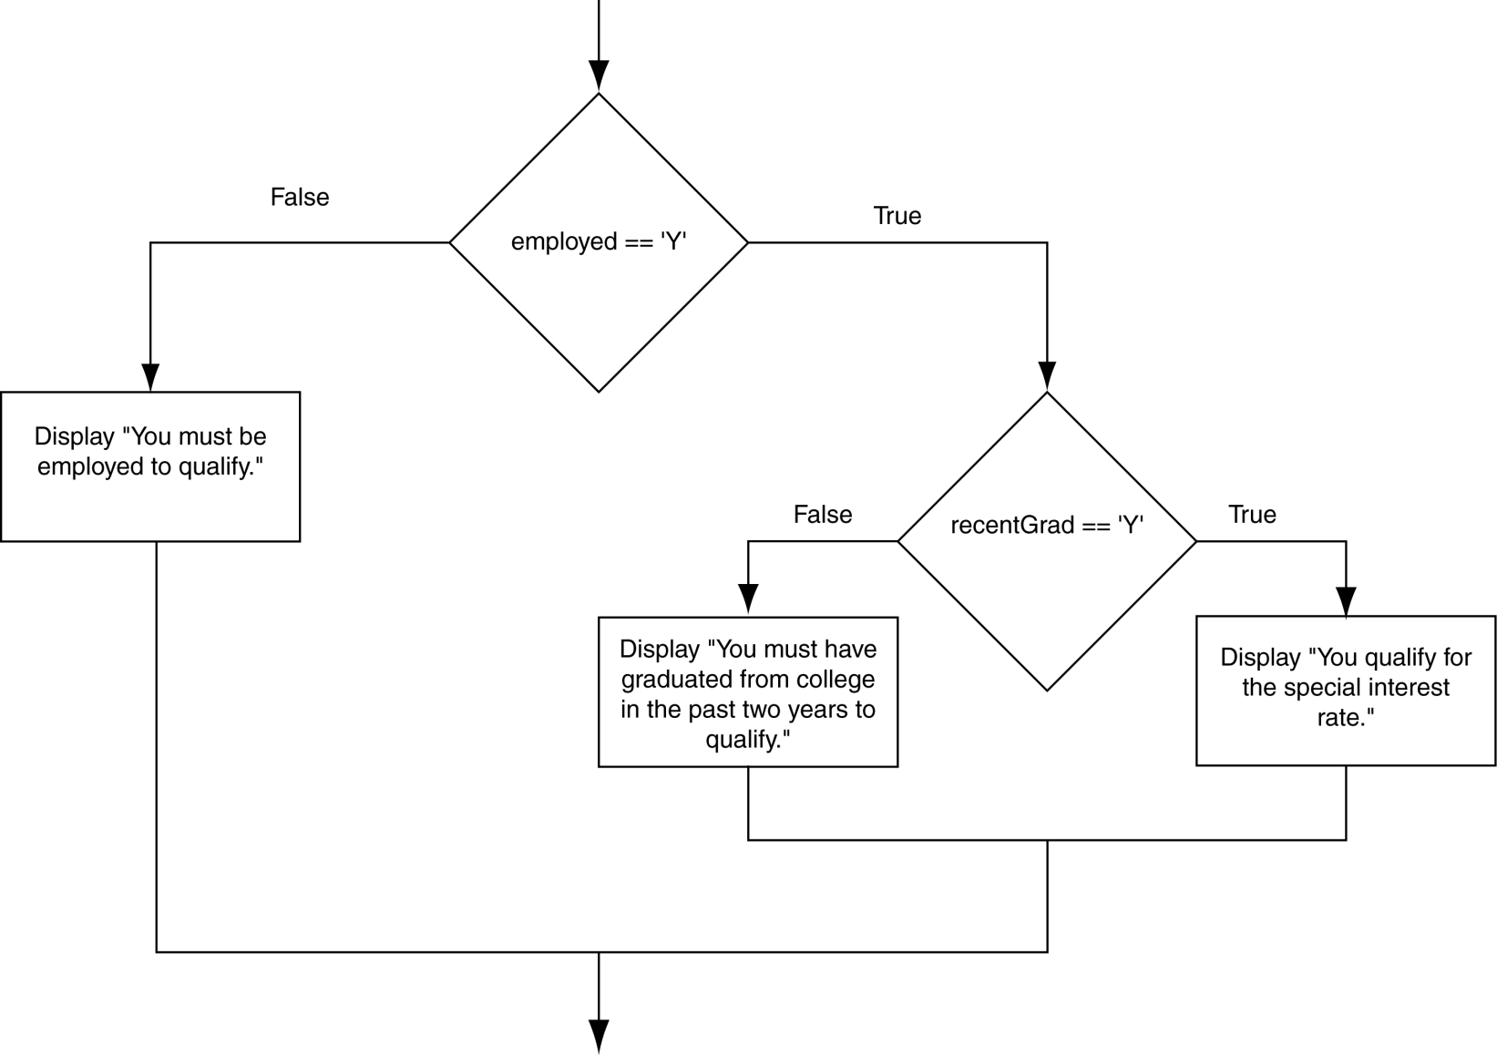
Flowchart for a Nested if Statement

Slide 13
Nested if Code
// Determine loan qualification
if (employed == ‘y’)
{
if (recentGrad == ‘y’)
{
cout << “You qualify!”
}
}
Note: this could be done with one if and two conditions.

Slide 14
Testing a Series of Conditions
Use if … else … if sequences to test a series of conditions:
If your score is over 90 your letter grade is A else if your score is over 80 your letter grade is B else your letter grade is C.

Slide 15
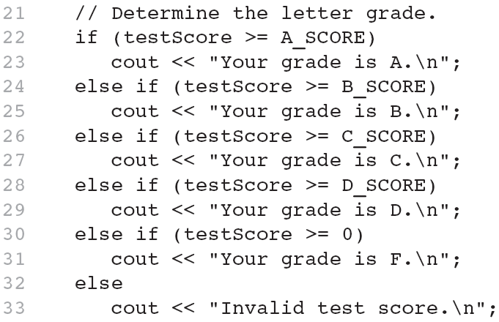
Catching Input Errors

Slide 16
The switch Statement
Used to select among statements from several alternatives
In some cases, can be used instead of if/else if statements

Slide 17
switch Statement Format
switch (expression) //integer
{
case exp1: statement1;
case exp2: statement2;
...
case expn: statementn;
default: statementn+1;
}

Slide 18
switch Statement Requirements
expression must be an integer variable or an expression that evaluates to an integer value
exp1 through expn must be constant integer expressions or literals, and must be unique in the switch statement
default is optional but recommended

Slide 19
How switch Works
expression is evaluated
The value of expression is compared against exp1 through expn.
If expression matches value expi, the program branches to the statement following expi and continues to the end of the switch
If no matching value is found, the program branches to the statement after default:

Slide 20
break Statement
Used to exit a switch statement.
If it is left out, the program "falls through" the remaining statements in the switch statement.

Slide 21
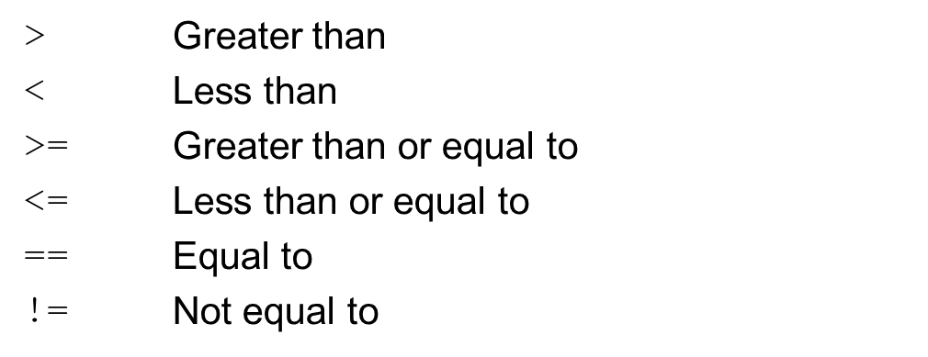
Relational Operators
Used to compare numbers to determine relative order
Operators:

Slide 22
Relational Expressions
Boolean expressions – true or false
Examples:
  12 > 5 is true
  7 <= 5 is false
  if x is 10, then
  x == 10 is true,
  x != 8 is true, and
  x == 8 is false

Slide 23
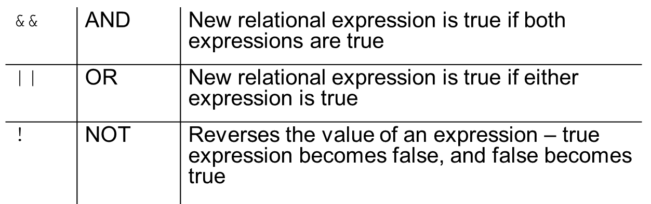
Logical Operators
Used to create relational expressions from other relational expressions
Operators, meaning, and explanation:

Slide 24
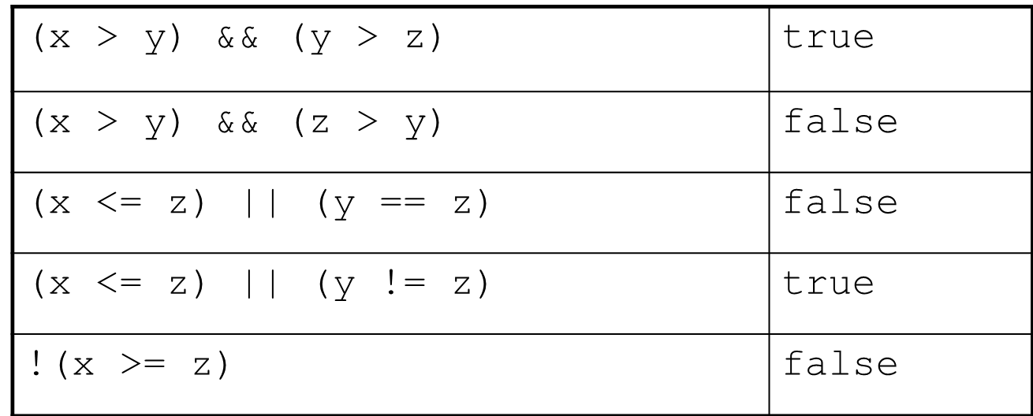
Examples of Logical Operators
int x = 12, y = 5, z = -4;

Slide 25
Logical Operators in code
// Determine loan qualification
if (recentGrad == ‘Y’ && employed == ‘Y’
{
cout << “You qualify!”;
}
else
{
cout << “You must be employed and”
<< “have graduated in the last 2”
<< “years to qualify\n”;
}

Slide 26
Logical || (or) in Code
// Determine loan qualification
if (salary >= MIN_INCOME || years > MIN_YEARS
{
cout << “You qualify!”;
}
else
{
cout << “You must earn at least ” <<
MIN_INCOME <<
“or have been employed at least “
<< MIN_YEARS << “ to qualify”;
}

Slide 27
Range Checking
Used to test to see if a value falls inside a range:
  if (grade >= 0 && grade <= 100)
  cout << "Valid grade";
Can also test to see if value falls outside of range:
  if (grade <= 0 || grade >= 100)
  cout << "Invalid grade";
Cannot use mathematical notation:
  if (0 <= grade <= 100) //doesn’t work!

